Slide 1
Scale Networks in Debussy
Dmitri Tymoczko, Journal of Music Theory 48.2 (2004), pp. 219–94.

Slide 2
scalar tradition
Section I discusses intuitive constraints on scale formation.
Section II: techniques of moving between scales based on shared subsets or efficient voice leading.
Section III applies this framework to the analysis of four of Debussy’s piano pieces.

Slide 3
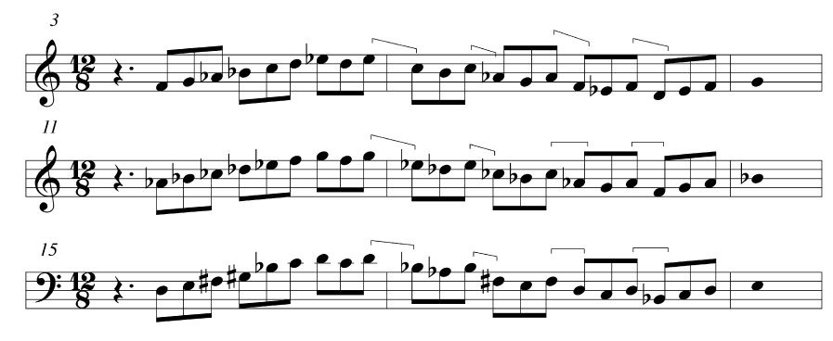
three scales from Fetes

Slide 4
Terminological Preliminaries
“chromatic distance” and “scalar distance”:
ascending registral ordering of all the pitches belonging to all the pitch classes in the set (cyclic).
The scalar interval from pc a to pc b is one ascending scale step if a immediately precedes b in the circular ordering;
two ascending scale steps if a immediately precedes a note that immediately precedes b, and so on.
“the set S” (or “the collection S”) refers to an unordered collection of pitch classes
“the scale S” is the unique circular ordering of those pitch classes “
scale class” and “scale type” refer to classes of scales whose associated sets are related by transposition

Slide 5
The term “mode” will be used to describe a scale in which a pitch class has been singled out as having priority over the others.
Collections used:
Diatonic, 2-2-1-2-2-2-1
Acoustic, 2-2-2-1-2-1-2
Harmonic minor, 2-1-2-2-1-3
Harmonic major, 2-2-1-2-1-3
Pentatonic, 2-2-3-2-3
Wholetone 1 and II, 2-2-2-2-2 (we will use WT0 and 1, or even/odd)
Octatonic I, II, III, 1-2-1-2-1-2-1-2 (we will use OCT0,1, OCT1,2, OCT2,3)
Hexatonic I, II, III, IV 1-3-1-3-1-3 (we will use HEX0,1, HEX1,2, HEX2,3, HEX3,4)

Slide 6
Three Scalar Constraints:
DS (“Diatonic Seconds”): If the scalar interval between two notes is one ascending step, then the chromatic interval between them is either one or two ascending semitones
NCS (“No Consecutive Semitones”): If the chromatic interval between any two notes is two ascending semitones, then the scalar interval between them is one ascending step; thus, a scale cannot contain successive one-semitone steps
DT (“Diatonic Thirds”): If the scalar interval between any two notes is two ascending steps, then the chromatic interval between them is three or four ascending semitones

Slide 7
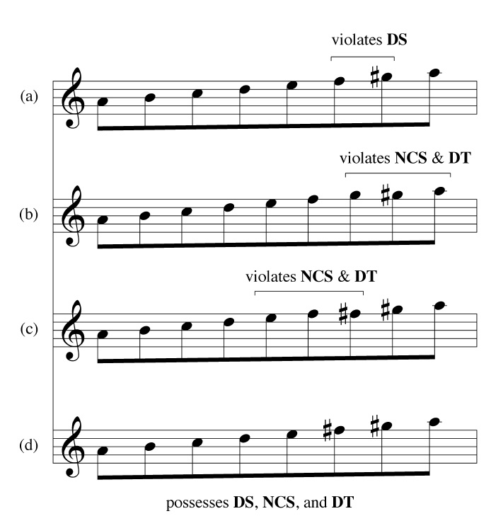
three scalar constraints: DS, NCS, DT

Slide 8
Locally Diatonic Scales
DS is inherited by supersets
DS scales are thus supersets of the minimal DS scales
These scales belong to just four types: diatonic, octatonic, whole-tone, and acoustic
These scales are “locally diatonic” within a three-note span: any three consecutive notes of one of these scales will be enharmonically equivalent to some three-note span of some diatonic scale
The NCS constraint is inherited by subsets; all sets satisfying the NCS constraint are subsets of the maximal NCS sets

Slide 9
Pressing scales (as collections)
Acoustic (7-34)
Diatonic (7-25)
Octatonic (8-28)
Whole-tone (6-35)
harmonic minor (7-32A)
harmonic major (7-32B)
Hexatonic (6-20)

Slide 10
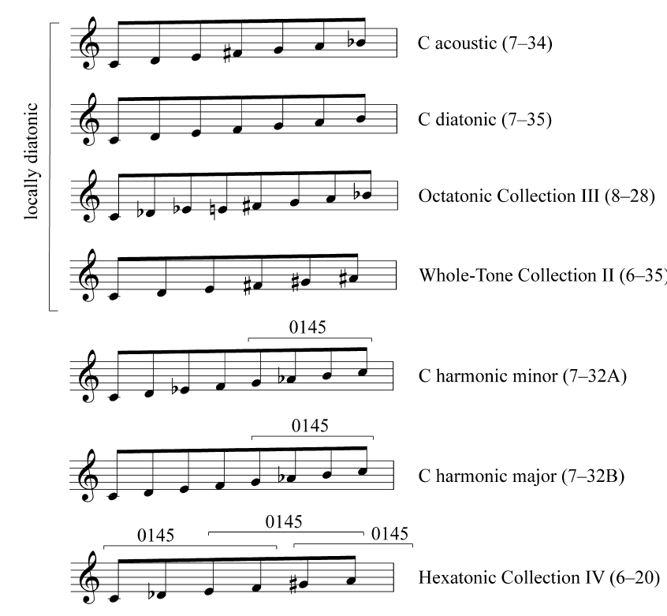
Pressing scales

Slide 11
Pressing scale features
Allow construction of tertian harmonies and stepwise melodies
All set classes formed by superimposing two triads of any quality

Slide 12
Maximal Anhemitonic Scales:
complements of DS sets
Four that follow DS+ constraint: If the scalar interval between any two notes is one ascending step, then the chromatic interval between them is two or three ascending semitones.
diminished 7th chord, 5-25 (02479), 5-34 (02469) dominant 9th pentachord, whole-tone.
Three scale types manifest DT+: If the scalar interval between any two notes is two ascending steps, then the chromatic interval between them is four or five ascending semitones.
In pentatonic, the near fourths are thirds as scale steps

Slide 14
Scalar “Dynamics”: Common-Tone and Voice-Leading Relations Between Scales
Maximally smooth voice leading—only a single pitch class moves by only a single semitone
Although using pc set terminology, our concern is scalar entities n conjunction with common-tone and voice-leading properties
Diatonic scale and maximal evenness

Slide 15
Common-tone relations
If S and T are sets, neither of which entirely contains the other as a subset, then they can share at most one note less than the cardinality of the smaller set
Two sets, not related by inclusion, maximally intersect when they share this maximum number of notes
Two set classes maximally intersect if there exist maximally-intersecting members of those two set classes.
A set class maximally intersects itself when two distinct forms of that set share all but one of their notes

Slide 16
Common-tone relations
Graphs for diatonic and Pressing scales show all possible maximal intersections
T-symmetrical Pressing set classes at top, 5th-based diatonic at bottom, harmonic and acoustic in between
Thus acoustic and harmonic mediate between T-symmetrical scales

Slide 17
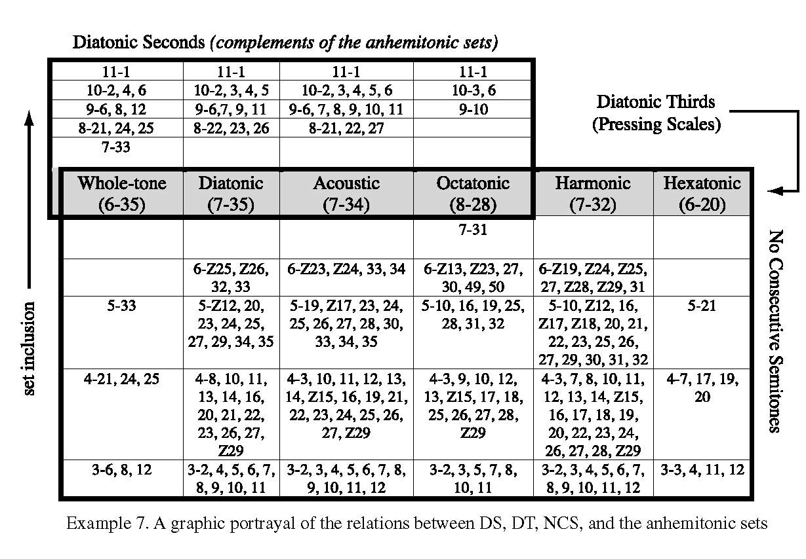

Slide 18
Voice-Leading Between Scales
Pressing diatonic, acoustic and harmonic set classes
Graph:
1. almost all of the maximally-intersecting collections are linked by maximally-smooth voice leading
2. maximally-smooth voice leadings come in inversionally-related pairs
The entire graph is inversionally symmetrical

Slide 19
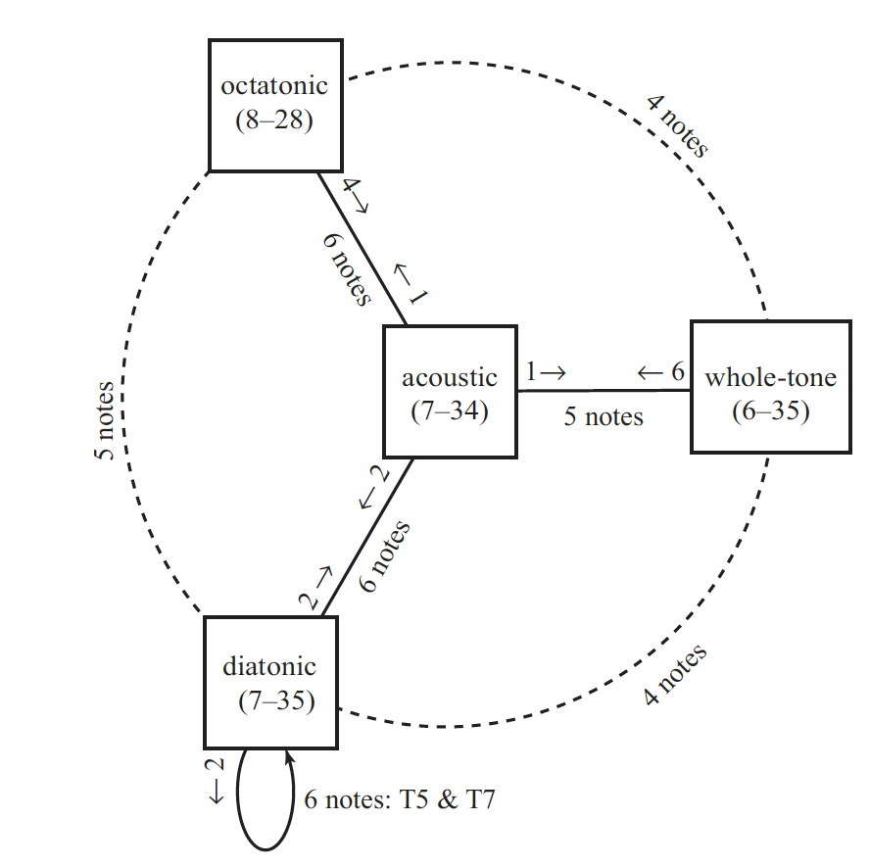
Maximal connections among the
4 locally diatonic scales

Slide 20
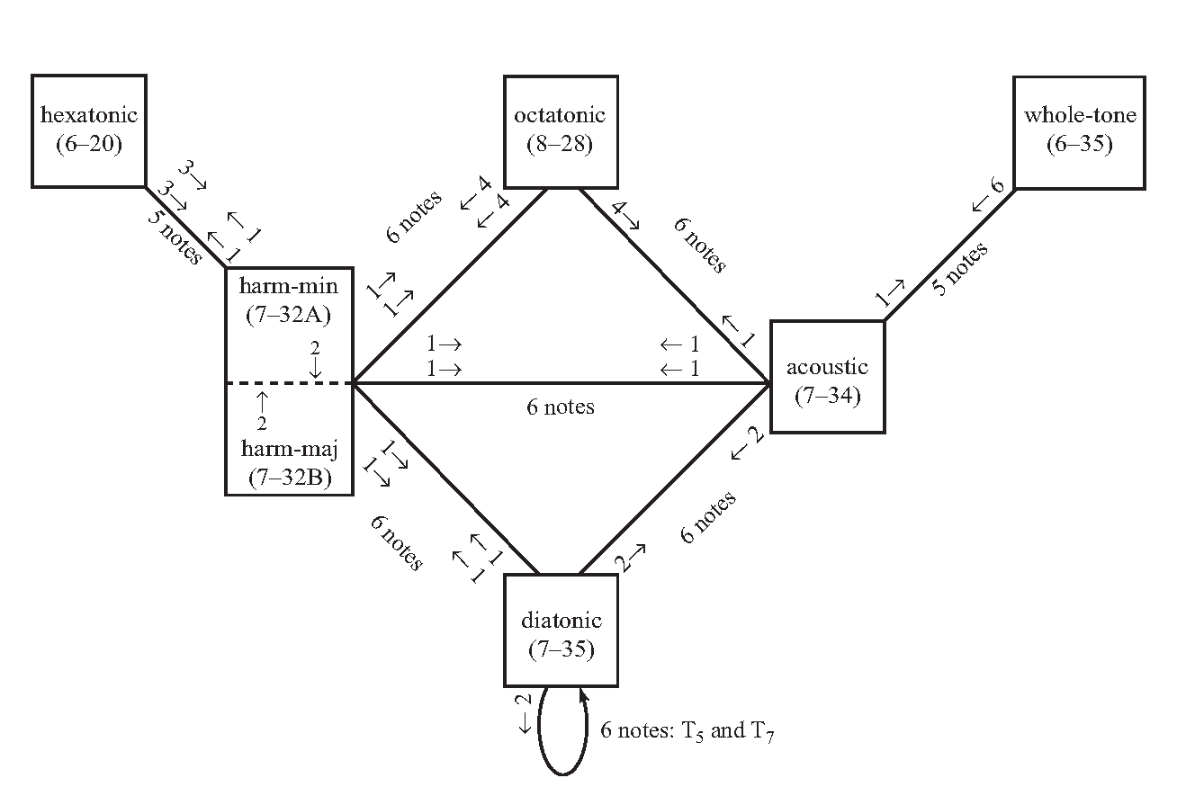
Maximal connections among the
7 Pressing scales

Slide 21
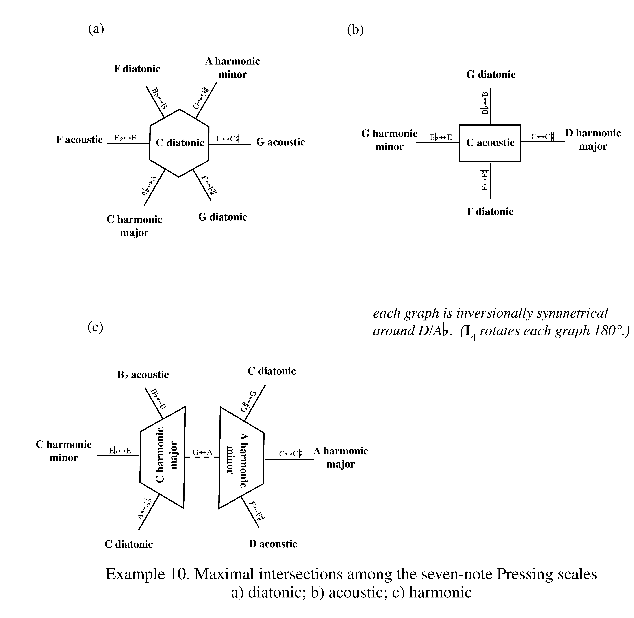

Slide 22
Scale relations as stacked cubes
Tymoczko's 3D geometric lattice of Pressing scales shows collections connected by maximally-smooth voice-leading; each collection is related to three others
Harmonic collections on the corners; acoustic collections on edges, diatonic collections within

Slide 23
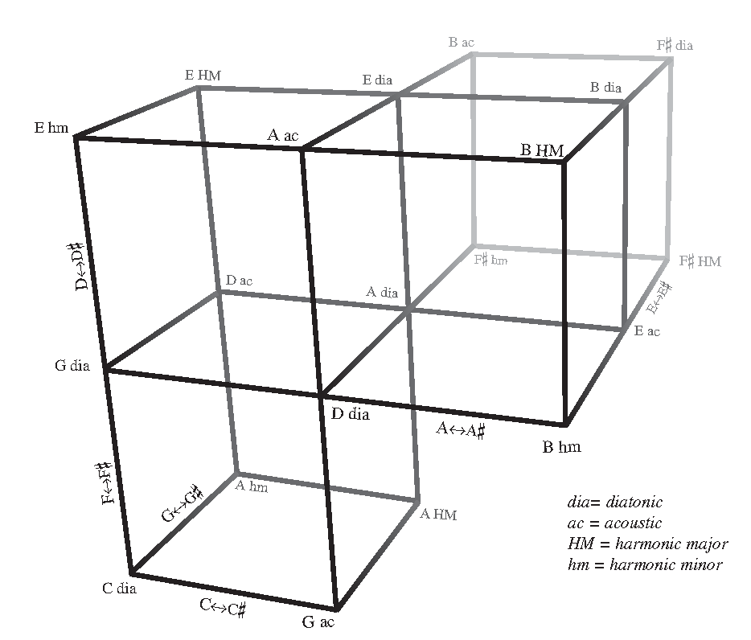
Scale lattice (partial) for 7-note Pressing scales

Slide 24
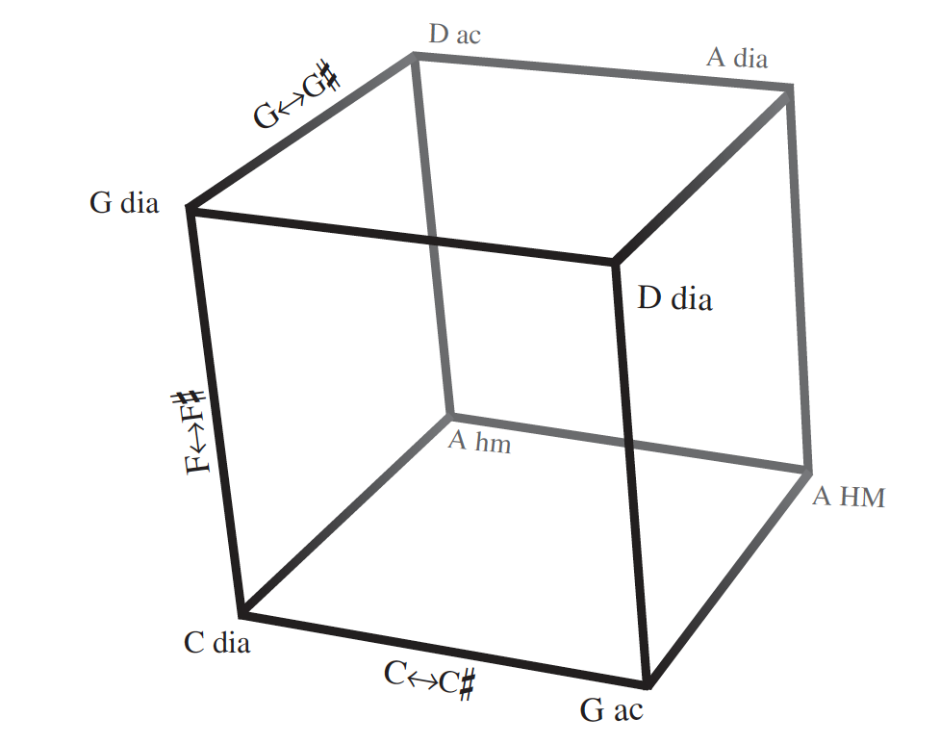
D-E-F#-G#-A-B-C
D-E-F#-G#-A-B-C#
A-B-C#-D-E-F#-G#
A-B-C#-D-E-F#-G
D-E-F#-G-A-B-C
G#-A-B-C-D-E-F#
D-E-F-G-A-B-C#
G-A-B-C-D-E-F#
A-B-C-D-E-F-G#
A-B-C-D-E-F-G
G#-A-B-C#-D-E-F
G#-A-B-C-D-E-F
C-D-E-F-G-A-B
G#-A-B-C#-D-E-F
C-D-E-F-G-A-B
C-D-E-F#-G-A-B
G-A-B-C#-D-E-F
Cohn’s scale cube: all 8 scales share D-E-A-B

Slide 25
Scale relations as intertwining strands
diatonic and non-diatonic
circle of fifths and a cyclic structure that also involves fifth transposition
G acoustic G-A-B-C#-D-E-F ⟷
A harm major A-B-C#-D-E-F-G# ⟷
A harm minor A-B-C-D-E-F-G# ⟷
D acoustic D-E-F#-G#-A-B-C ⟷
E harm major E-F#-G#-A-B-C-D# ⟷
E harm minor E-F#-G-A-B-C-D#

Slide 26
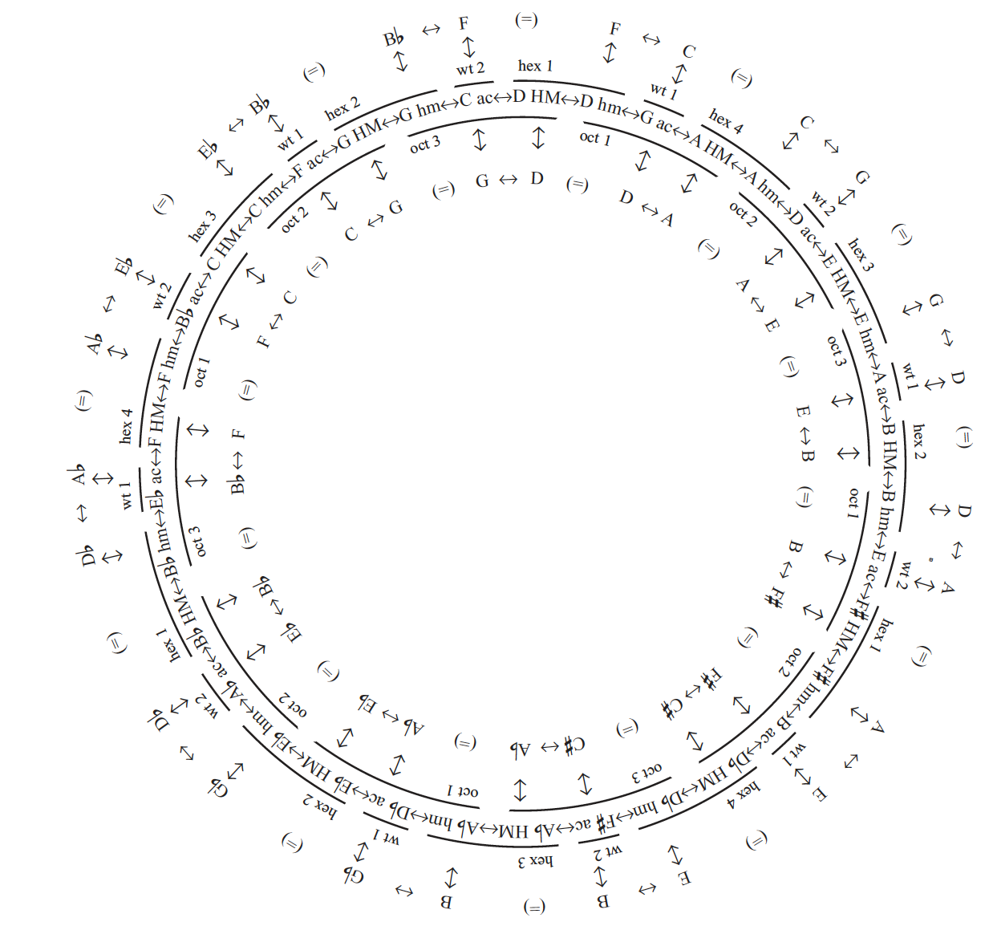
Circle of 5th-related non-diatonic scales

Slide 27
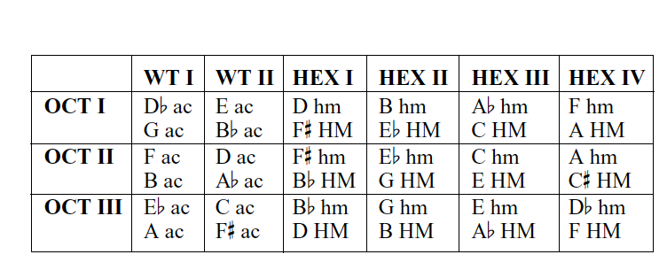
Oct I:124578t e
Bhm: 12467t e
EbHM:23578t e
HexII: 02 4 6 8 t
Oct I: 124578t e
Abhm: 13478t e
CHM: 024578 e
HexIII: 034 78 e
Oct I: 124578t e
Dbac: 13578te
Gac: 124579e
WTI: 1 3 5 7 9 e
Oct I: 124578 t e
Fhm: 014578 t
AHM: 12458 9 e
HexIV: 01 45 89
Oct I:124578t e
Eac: 124 6 8t e
Bbac:024578t
WTII:02 4 6 8 t
Oct I: 124578t e
Dhm: 12457 9 t
F#HM:12568t e
HexI: 12 56 9 t
Maximal intersections involving T-symmetrical scales
OCT I=1,2; OCT II=2,3; OCT III=0,1

Slide 28
Debussy’s music: why scalar analysis?
1. Debussy uses only diatonic, pentatonic, acoustic & whole-tone
2. these scales are familiar
3. Debussy uses these scales in a limited number of modes
4. Debussy changes scales slowly
5. Debussy uses scales melodically

Slide 29
Les Collines d’Anacapri
three thematic ideas:
a rising pentatonic figure;
a descending scale fragment touching on six notes of the diatonic scale;
melody that starts with a six-note diatonic scale-fragment and ends by emphasizing the “black-note” pentatonic scale.

Slide 30
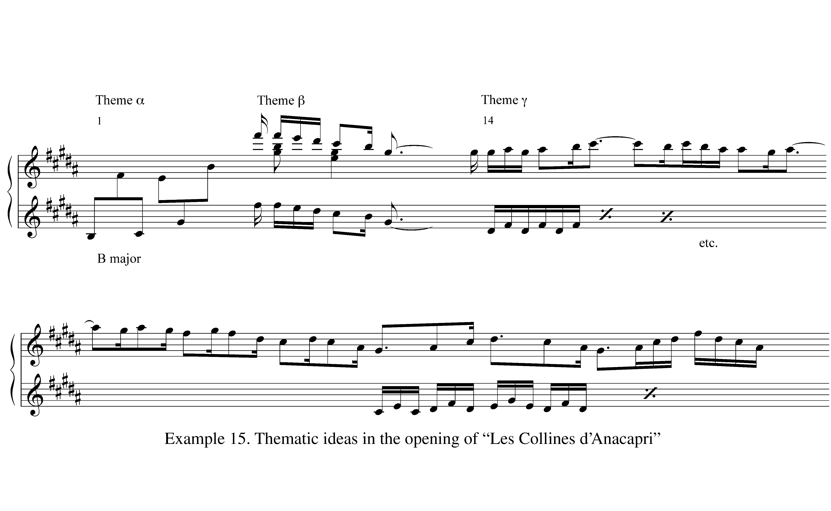

Slide 31
The first 61 mm. rarely depart from the tonic B major
mm. 24–29 present A–Bb–C–Db–Eb–F#, common to Bb harmonic minor and Octatonic III (OCT0,1)
mm. 46 and 51 chromatic passing notes.
These thematic ideas absent from mm. 24–61, but return in the last third of the piece, are detached B major set in the context of new scales.

Slide 32
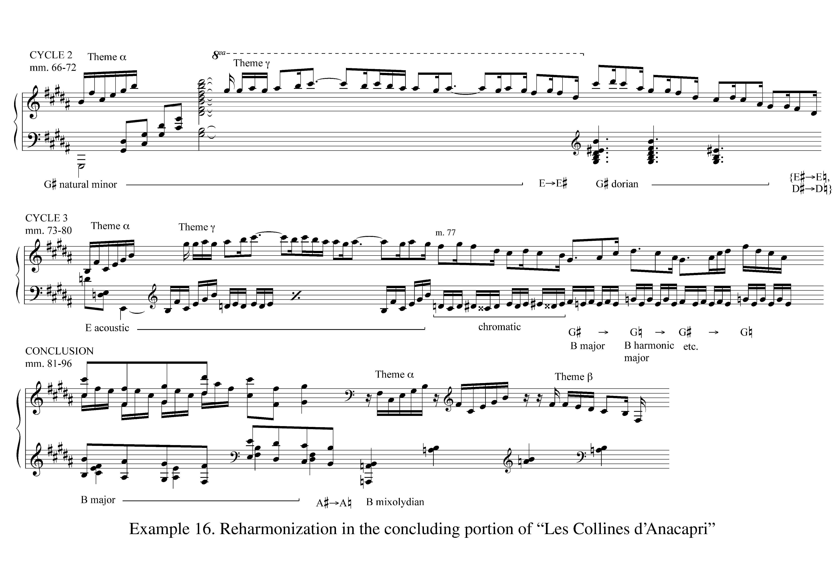

Slide 33
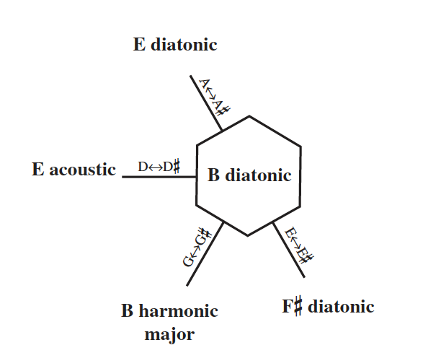
2. this central collection also serves as a stable tonic scale.
1. note that this is centered,
3. the scales are presented with different degrees of explicitness.
Diatonic and acoustic scales are complete, but harmonic major
(like the octatonic) is incomplete, fleeting, and ambiguous.
four of the six scales maximally intersecting the tonic B major in “Les Collines d’Anacapri”

Slide 34
Theme y contains the six pitch classes common to B diatonic and F# diatonic and appears in both scales
Theme ℬ contains the six pitch classes common to B diatonic and E diatonic, and again
appears within both scales.
Theme a contains the five pitch classes common to the three scales in which it appears:
B diatonic, E diatonic, and E acoustic.
“Collines” distinguished by the way the themes themselves articulate subsets
shared by its maximally intersecting scales

Slide 35
Le vent dans la plaine
“Le vent dans la plaine,” begins with an ostinato pattern involving Bb–Cb with a simple four-note melody that may suggest pentatonic .
The mode is Bb Phrygian, although one can hear Eb natural minor.
m. 5 shifts Eb to Ebb (the third mode of Gb harmonic major).
the ostinato returns to Bb phrygian in m. 7

Slide 36
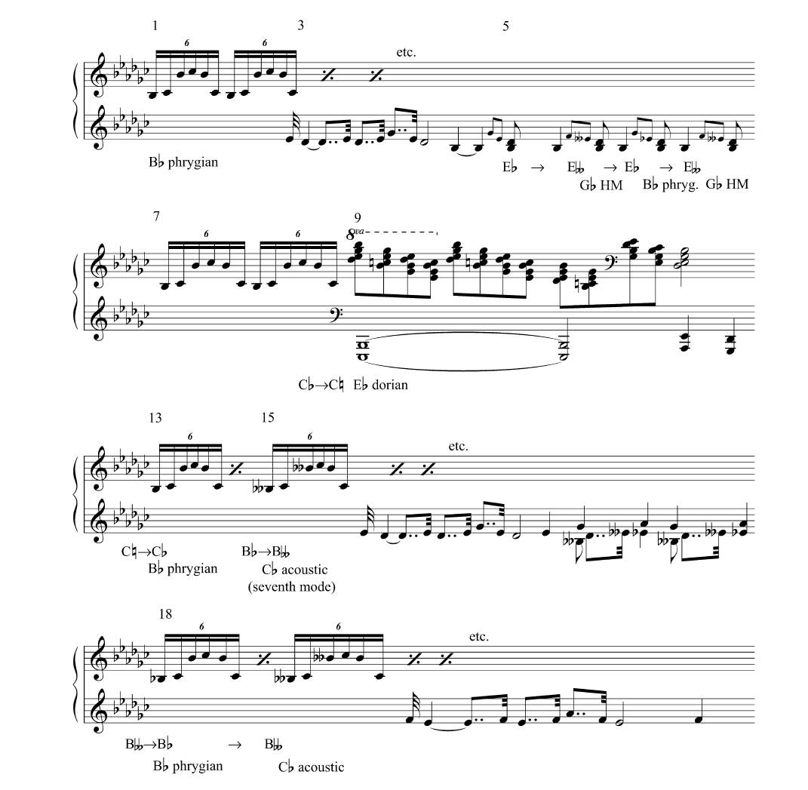
new theme: a series of descending 7th chords over parallel fifths in the bass
C♮ has replaced Cb, yielding Eb dorian (an extended dominant?)
the ostinato reinstates Cb
The pentatonic tune returns in an acoustic context
Bb becomes Bbb in m. 15; the seventh mode of the Cb acoustic scale?
original ostinato returns
Summary of “Le vent dans la plaine”

Slide 37
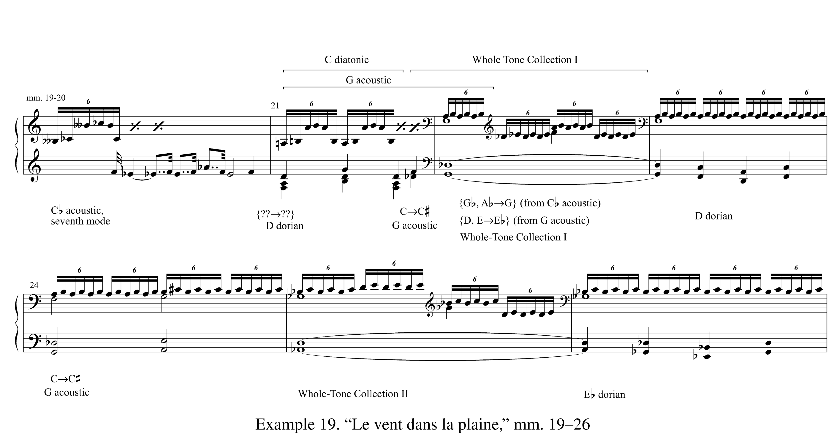
maximal intersections:
inversion of Bb phrygian→
Cb acoustic→
Whole-Tone I
progression of maximally intersecting scales
the acoustic scale reappears
white-note scale!
more Dorian
original ostinato
transposition by 1
Dominant 9th chords?
more Dorian

Slide 38
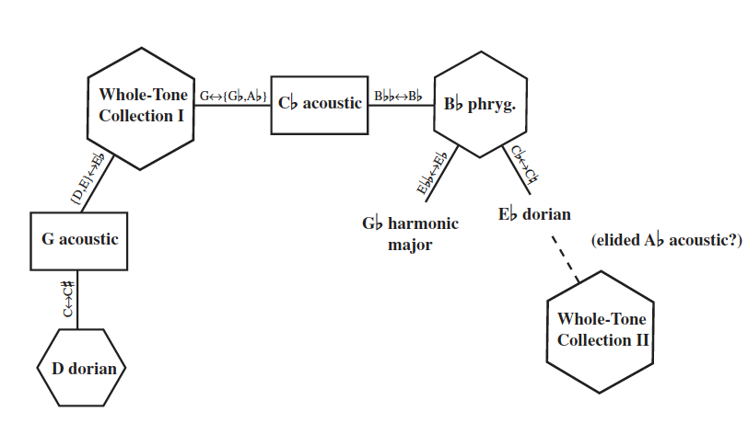
As before, a central diatonic scale connected by maximally-smooth voice-leading to three 7-note scales
And Eb dorian is itself associated with the other whole-tone scale
Yet the Cb acoustic collection maximally intersects WT I, and WT I doesn’t maximally intersect Bb phrygian
And this WT scale keeps intersecting new scales with no maximal intersection with Bb phrygian
But they can be heard as an elided transposition of the earlier D dorian-G acoustic-Whole-Tone I progression

Slide 39
L’Isle Joyeuse
L’Isle Joyeuse uses only the four locally diatonic scales
the central collection in L’Isle Joyeuse is an acoustic scale
it makes greater use of cardinality-changing shifts of scale
Thus a greater structural integration of whole-tone and octatonic collections

Slide 40
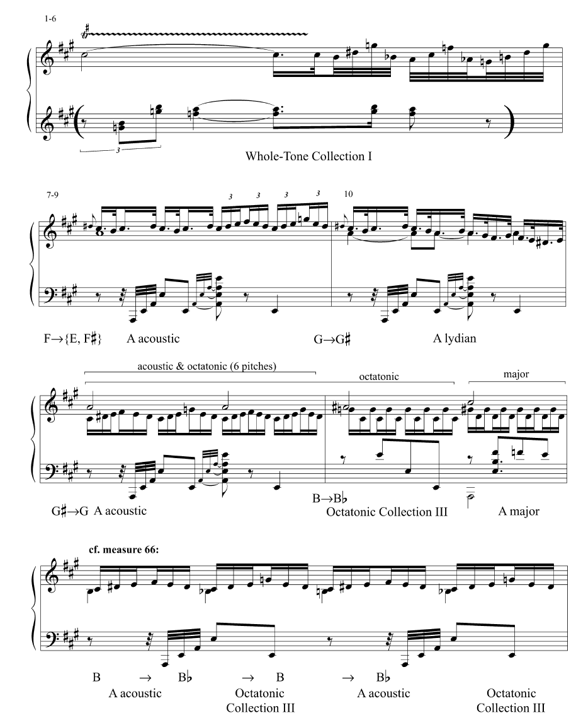
Three sections:
1–51;
52–159;
160–
WT divides
I and II
Tonic region in “L’isle joyeuse”

Slide 41
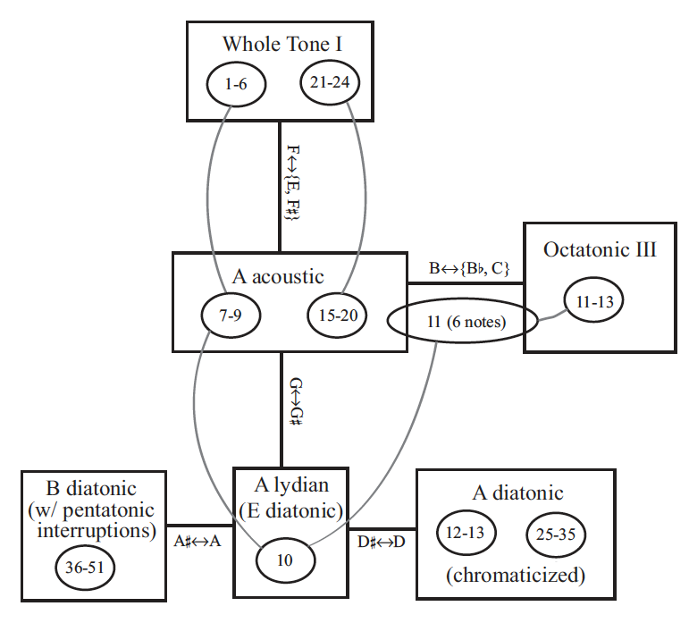
squares = scales
ovals = m. #
curved lines =
maximal intersections
Scales in “L’isle joyeuse,”

Slide 42
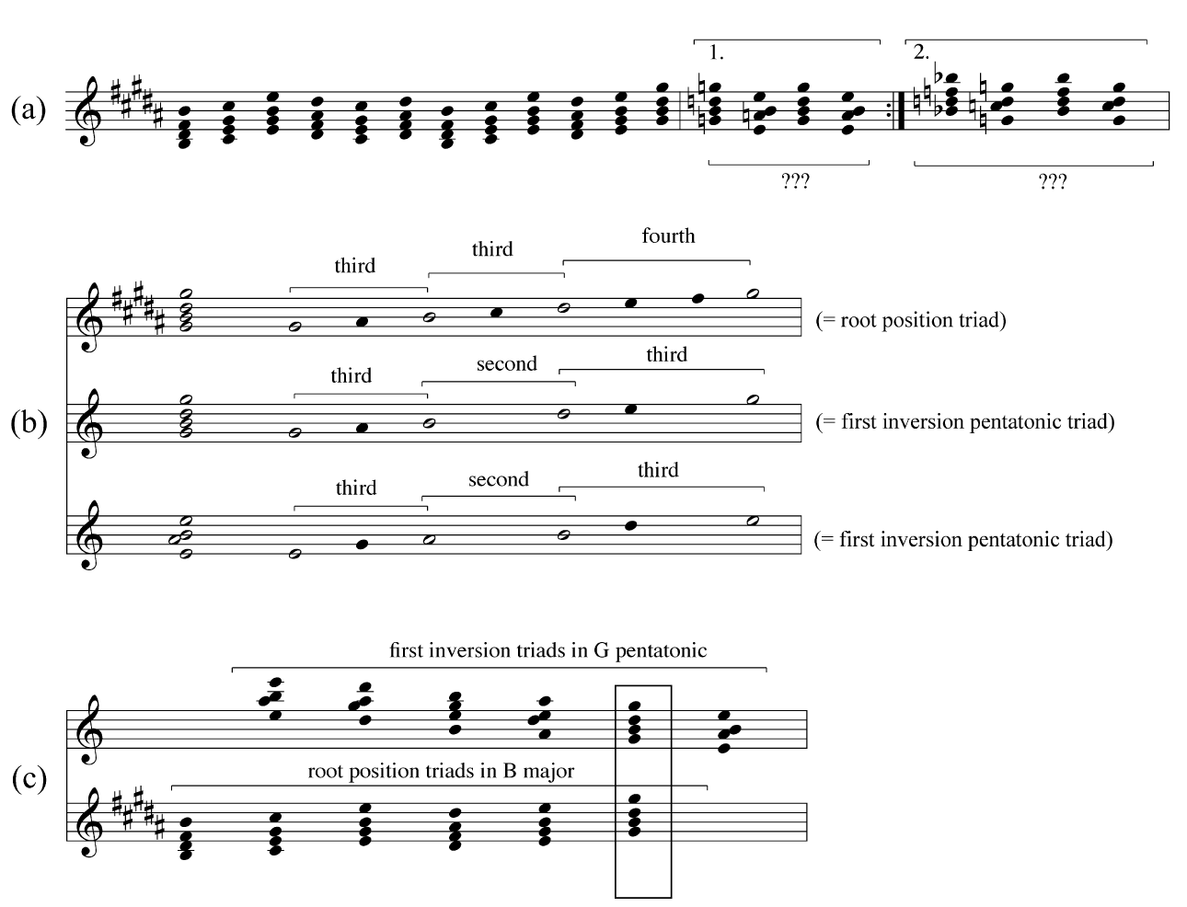
a) a reduction of measures 36–51
b) diatonic and pentatonic triads
c) mm. 36–43 as composed of parallel chords in two scales
Parallel triads in “L’isle joyeuse,”

Slide 43
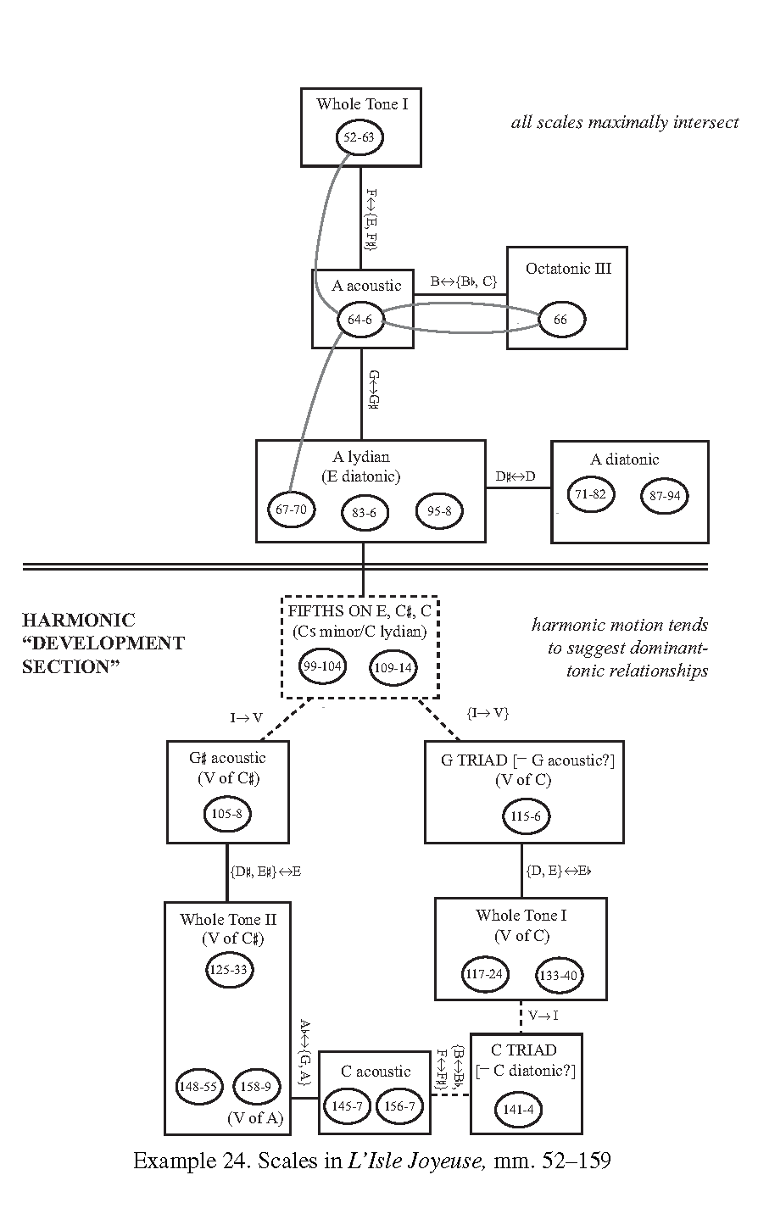

Slide 44
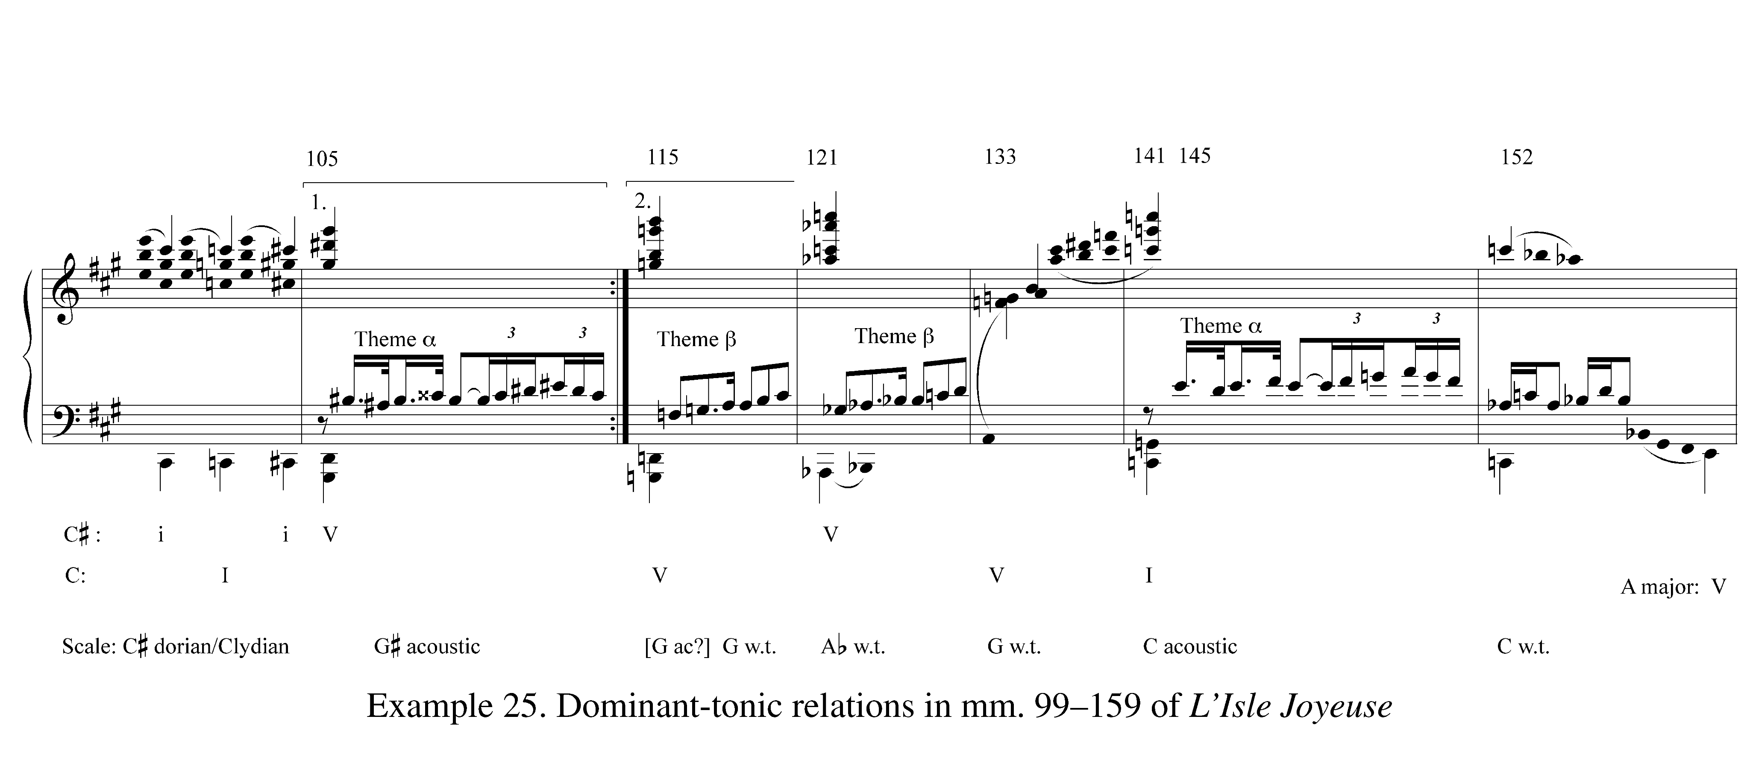

Slide 45
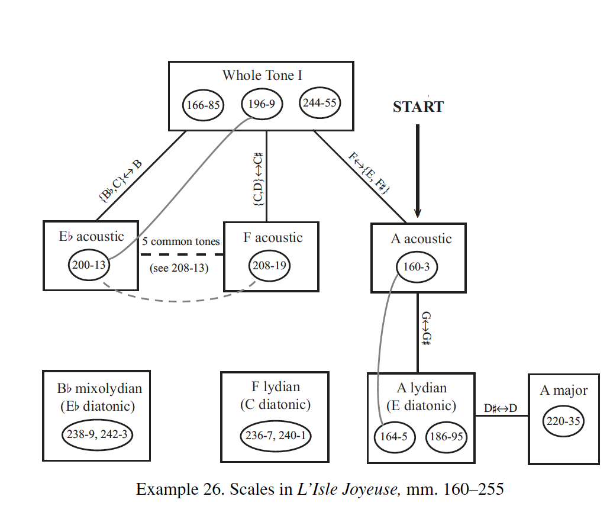

Slide 46
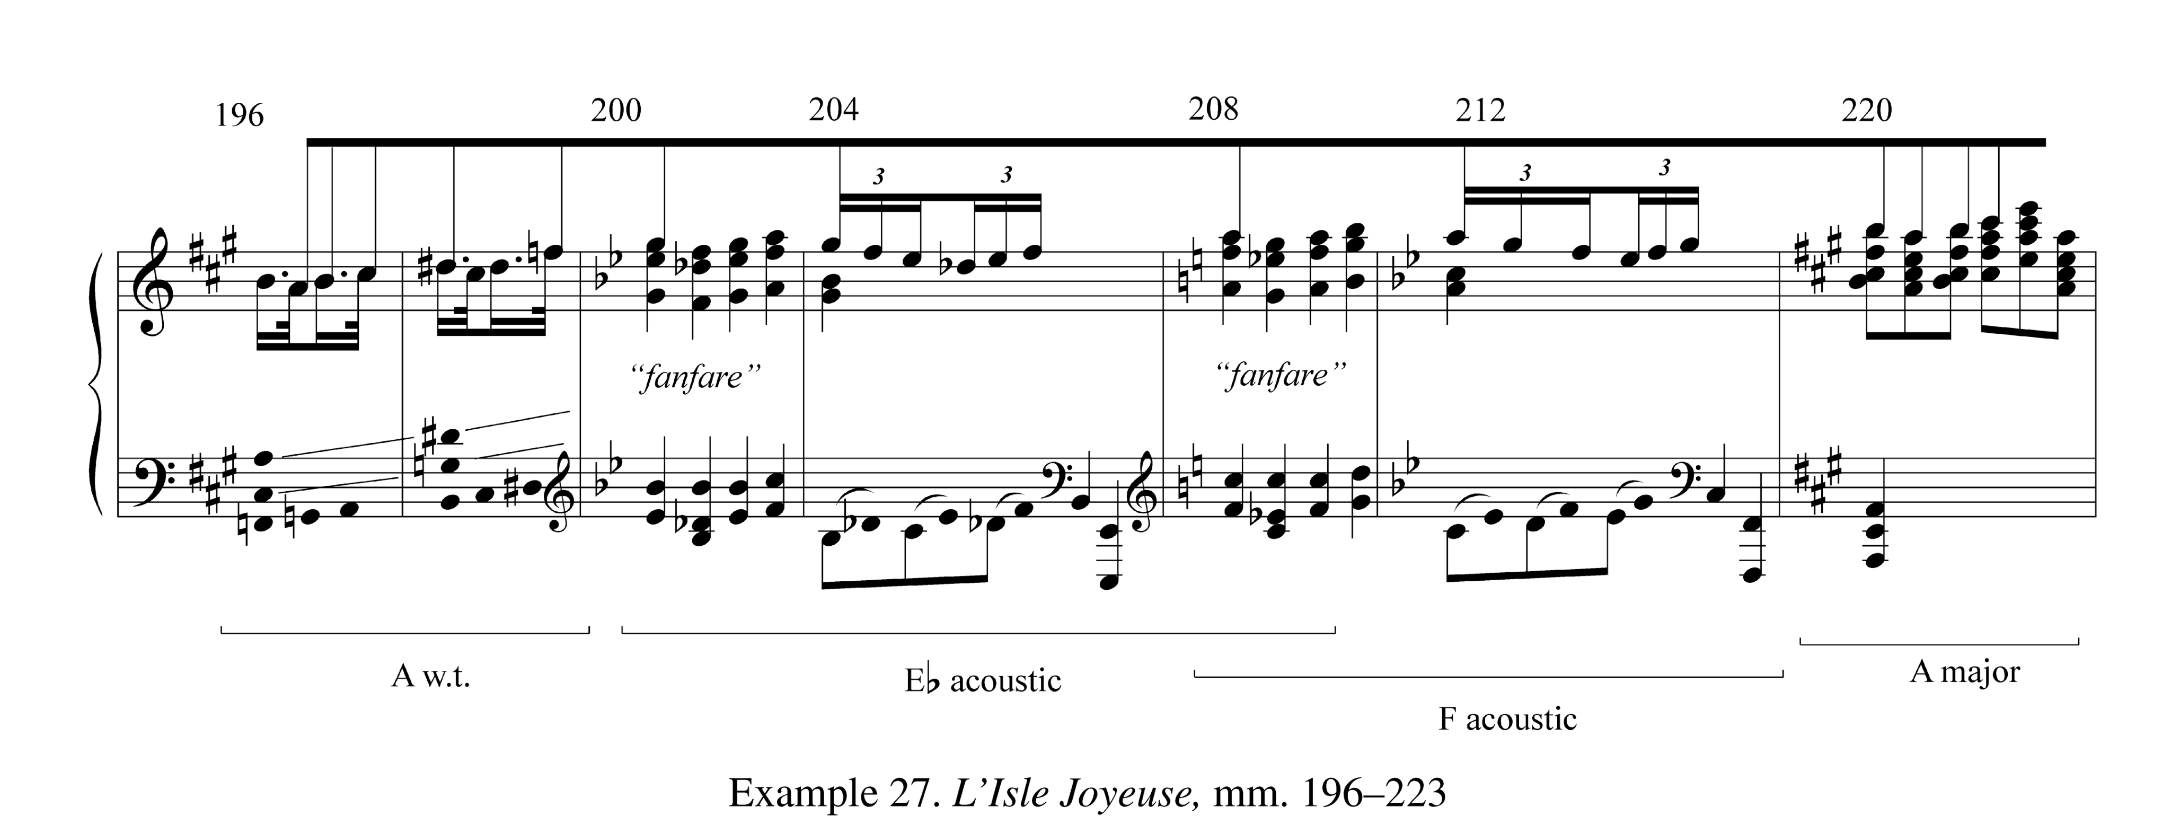

Slide 47
Cloches à travers les feuilles
More tenuous scale presentations
maximally intersecting scales play a role at four places two local, and two of which connect distant passages of music.
Gamelan influence?

Slide 48
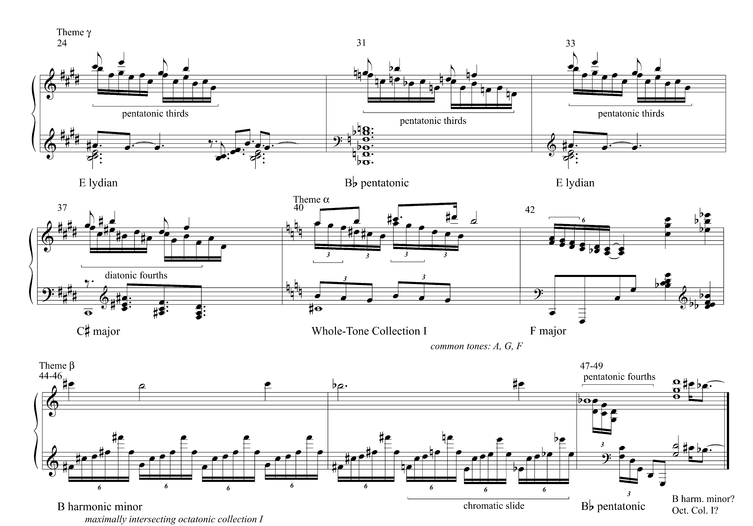
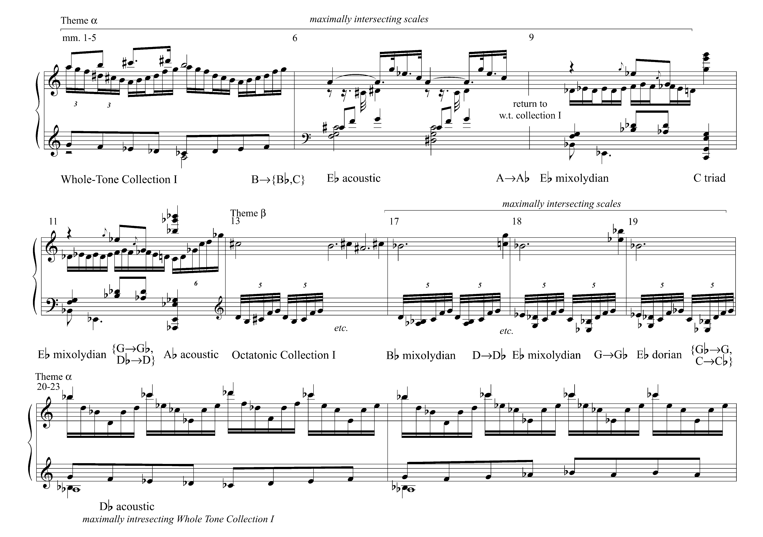
Thematic harmonic summary “Cloches à travers les feuilles”

Slide 49
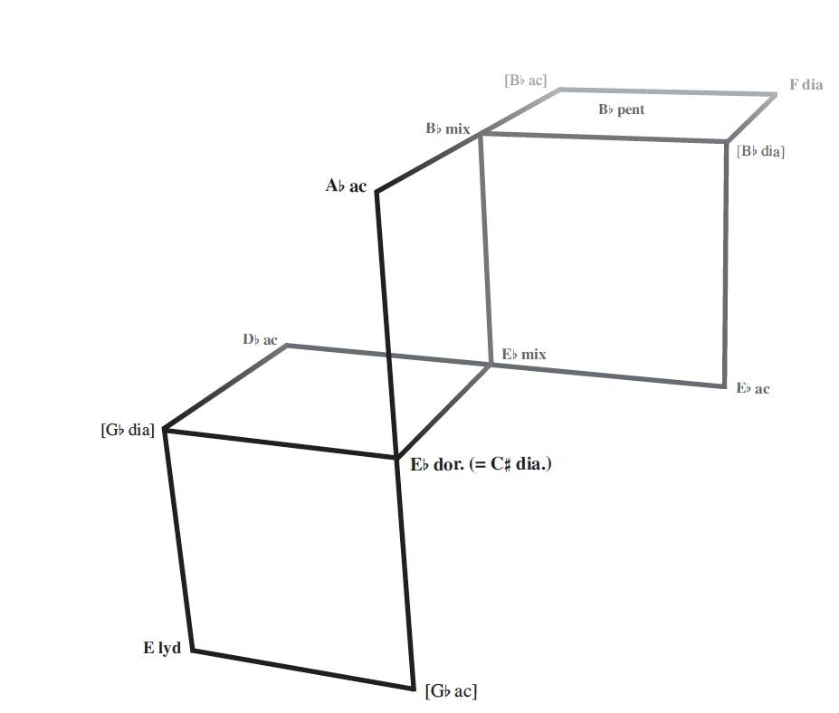
Scale relations in “Cloches à travers les feuilles”

